Slide 1


Slide 2
While loop
Consider this loop:
n = 5
while n > 0:
n -= 1
print(n)
..............................................
Output:
4
3
2
1
0
The format of a while loop is shown below:
while <expr>:
<statement(s)>
<statement(s)> represents the block
to be repeatedly executed, often
referred to as the body of the loop.
This is denoted with indentation,
just as in an if statement.

Slide 3
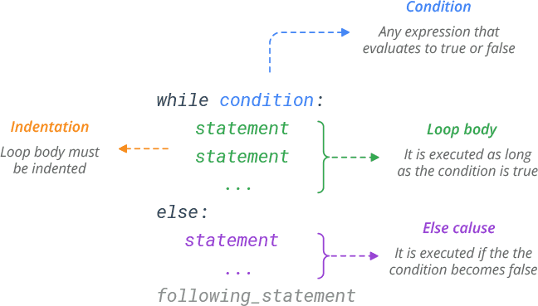
The else Clause
Python allows an optional else clause at
the end of a while loop. This is a unique
feature of Python , not found in most
other programming languages.
The syntax is shown below:
while <expr>:
<statement(s)>
else:
<additional_statement(s)>
The <additional_statement(s)> specified in the else clause will be executed when the while
loop terminates.
Hence, a while loop's else part runs if no break occurs and the condition is false.
3

Slide 4
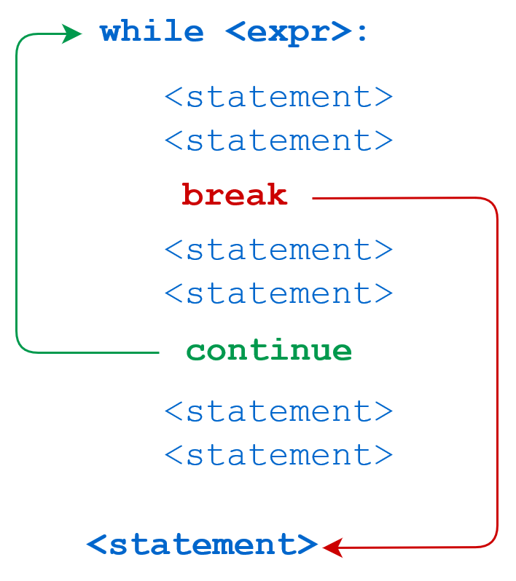
Python break and continue Statements
The Python break statement immediately terminates a loop entirely. Program execution proceeds to the first statement following the loop body.
The Python continue statement immediately terminates the current loop iteration. Execution jumps to the top of the loop, and the controlling expression is re-evaluated to determine whether the loop will execute again or terminate.
example

Slide 5
break
continue
* n = 5
while n > 0:
n -= 1
if n == 2:
break
print(n)
print('Loop ended.')
out put:
4
3
Loop ended.
* n = 5
while n > 0:
n -= 1
if n == 2:
continue
print(n)
print('Loop ended.')
Output:
4
3
1
0 Loop ended.

Slide 6

An infinite loop is an instruction sequence that loops endlessly
Example
while True:
print('foo')
output:
foo
foo
foo
foo
……..
This code was terminated by Ctrl+C, which generates an
interrupt from the keyboard. Otherwise, it would have gone on unendingly.
Here’s another variant of the loop shown above that
successively removes items from a list using .pop() until it is empty:When ’a’ becomes empty, not a becomes true, and the break statement exits the loop.
a = ['foo', 'bar', 'baz']
while True:
if not a:
break
print(a.pop(-1))
Output:
baz
bar
foo

Slide 7
Nested while Loops
Similarly, a while loop can be contained within another while loop.
A break or continue statement found within nested loops applies to the nearest enclosing loop:
If break statement is inside a nested loop (loop inside another loop), break will terminate the innermost loop.
while <expr1>:
statement
statement
while <expr2>:
statement
statement
break # Applies to while <expr2>: loop
break # Applies to while <expr1>: loop

Slide 8
Additionally, while loops can be nested inside
if/elif/else statements and vice versa:
if <expr>:
statement
while <expr>:
statement
statement
else:
while <expr>:
statement
statement
statement
Additionally, while loops can be nested inside
if/elif/else statements and vice versa:
while <expr>:
if <expr>:
statement
elif <expr>:
statement
else:
statement
if <expr>:
statement

Slide 9
One-Line while Loops
a while loop can be specified on one line. If there are multiple statements in the block that makes up the loop body, they can be separated by semicolons (;):
n = 5 while n > 0: n -= 1; print(n)
Output:
4
3
2
1
0

